Slide 1
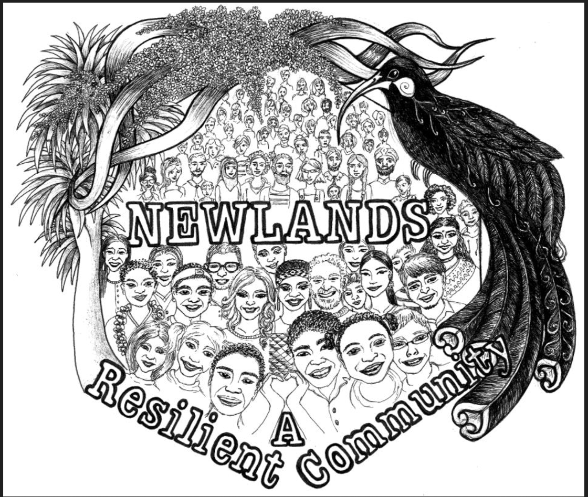
Newlands Resilience Group
Working to achieve our vision together
VISION 2030
“Aotearoa Community Resilience Network” Charitable Trust
24th May 2023

Slide 2
Vision 2030
A connected, prepared, and proactive community:
connected to others, regardless of differences. Community Resilience
prepared to respond to, and recover from emergencies. Disaster Resilience
proactive in speaking with Our voices into decision-making and seeking solutions.
Newlands, Paparangi, Woodridge, Bellevue

Slide 3
Values
The true measure of any society can be found in how it treats its most vulnerable members.
A resident could be economically capable but culturally vulnerable.
A community can be resilient if a holistic and sustainable approach is taken to the wellbeing of its people.
A resident, particularly a vulnerable one, is more confident if his or her community is resilient.
We aspire to five principles that:
people find fulfilment in community relationships, rather than simply in consumption and leisure,
people understand their role within society rather than being a collection of individuals,
people are free to help others, rather than wanting freedom from others,
there is competition and cooperation, and
the focus is on wellbeing rather than simply material wealth
A suburb is more likely to be disaster resilient if it is firstly community resilient.
Connecting to and leveraging existing networks i.e. not introducing something new

Slide 4
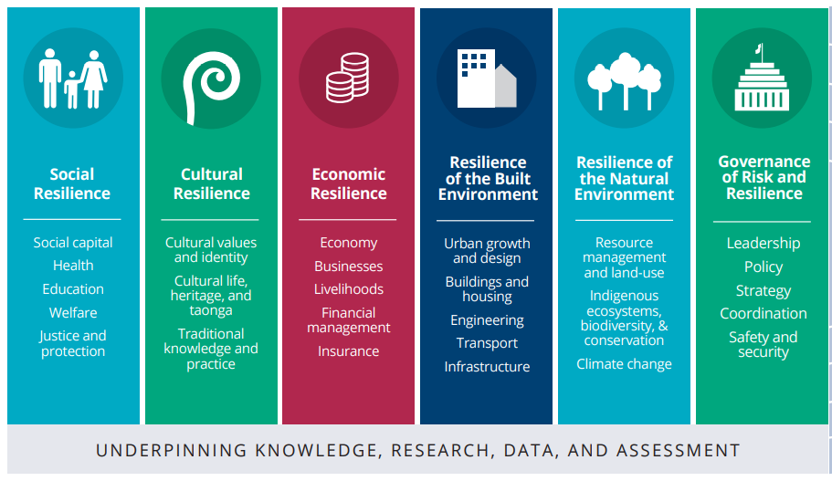
Wider Context
based on the six areas of resilience

Slide 5
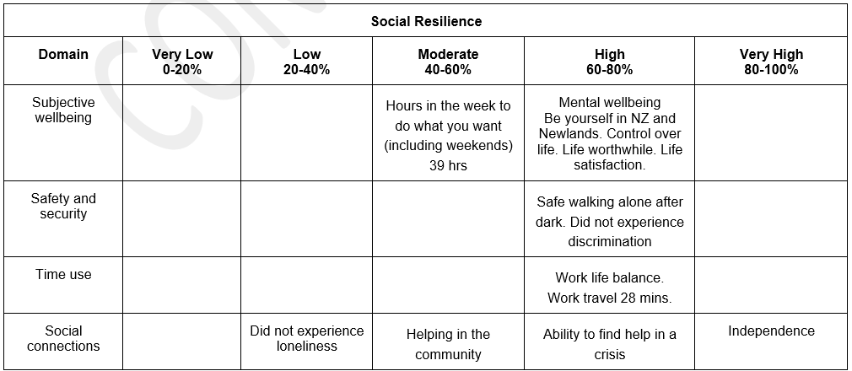
Our performance the past 4 years
Our vulnerabilities (<60%) and strengths (>60%) and in each resilience area by survey question by domain (Treasury’s living standards framework)
We want to focus on achieving a minimum 60% on each survey question by 2030

Slide 6
The problem with the current state
Social
Disconnected and uncoordinated provider centric social system of services and supports making it difficult for:
residents needing help to access the services they need resulting in loneliness.
residents don’t know how to effectively help resulting in a moderate level of helping in the community causing low social connections.
not-for-profit providers to sustainably provide services when needed by residents
Culture (ethnic and religious)
Separate approach within each culture with low participation in cultural activities and moderate sharing of cultural knowledge.
Royal Commission of Inquiry into the terrorist attack
Suggested people share knowledge and improve their understanding of social cohesion through social inclusion
Suggested the value that ethnic and religious diversity can contribute to a well-functioning society.
Economic
Provider competitive profit centric economic system making it difficult for some residents to access the opportunities needed given the potential moderate recession.
Community Resilience

Slide 7
The problem with the current state
Built Environment-Disaster resilience
The disaster resilience approach comprises Risk reduction, Readiness, Response, and Recovery, with different roles for each of the R’s:
at home
across community (including Marae networks and Businesses)
from Local Government
from Central Government.
Given only a moderate number of homes are prepared for a disaster, given half the residents are outside of Newlands during the day, and the lack of a home and community system, it is unclear whether Newlands is ready for and able to respond to a disaster, especially in the first 7 days, as the Local and Central Government system gears up.
Currently the risks we are facing are
Ngauranga Gorge vulnerable to liquefaction potentially compromising road access from coast to Johnsonville and access from SH 1 and Johnsonville into Newlands
several water tanks vulnerable to bursting potentially causing flooding and water supply difficulties (only x% homes with effective storm water drainage)
significant groupings of dense bush vulnerable to fire
Newlands Road built beside a creek vulnerable to flooding in heavy rain
power and telecommunications networks from seismic or extreme weather events
Disaster Resilience

Slide 8
The problem with the current state
Governance
There is a low trust in local Council and a moderate trust in Parliament.
Social and Cultural providers find it hard to provide support to staff and volunteers, develop new services, meet service demand, collaborate with other organisations, fundraise, market, and communicate, maximise digital technology, innovate, govern, grant writing, influence, and access to information and data in one place. Time to Shine Report by Volunteer NZ, Philanthropy NZ, the Centre for Social Impact and Hui E.
There are a variety of ideologies that are used to guide decision making depending on the political parties, however most parties generally support more devolvement of power locally.
The Treasury’s 2023 Wellbeing Report highlighted next steps to focus on:
collective rather than individual wellbeing
solutions drawing on local intelligence, not just top down
working with Maori to honour Treaty and focus on environmental wellbeing
resilience recovery, not just response
medium to long term planning with trade-offs
Natural Environment
There is a moderate confidence that land is being used for its optimal purpose.
Speaking with Our Voices

Slide 9
The future state
Social
To improve the effectiveness and efficiency of and easy access to social services to improve social connections (less loneliness and increased helping in the community)
Cultural
To improve participation in cultural activities and sharing of cultural knowledge
Economic
To improve the effectiveness and efficiency of the economic system by providing better access to economic opportunities
Natural Environment
To improve confidence that land is being used for its optimal purpose.
Built Environment-Disaster Resilience
To improve disaster resilience of Home and Community
Governance
To improve trust between Community, Council and Parliament; enable social and cultural providers to thrive; focus on collective wellbeing, work with Maori to honour Treaty, proving local intelligence to inform decision making, medium to long term recognising that whatever mix of ideologies held by political parties, they generally support more devolvement of power locally.
Community Resilience
Disaster Resilience
Speaking with Our Voices

Slide 10
How to achieve the future state
Do Mod for 2024 and consider Do Max in 2026
Meet: Partly Meet, Fail
Dimensions | Status Quo | Potential Choices by Dimension
Solution: Social and Cultural | Uncoordinated provider centric social services system disconnected to users with separate cultural approaches | Coordinated provider centric social and cultural services system with improved services partly connected to users Min | Coordinated provider centric social and cultural services system with improved services more connected to users Mod | User (Family, Whanau) centric social and cultural services system with high quality accessible services Max
Solution: Economic | Competitive profit centric economic system | Economic expo’s Min | Economic expo’s and leverage connections to existing networks in the city Mod | Cooperative and competitive, and profit and people centric economic system Max
Solution: Built Environment –Disaster Resilience | Uncoordinated home and community disaster system | Coordinated home and community disaster system Min and Mod | Relational home and community disaster system Max
Delivery | Mixed | Community (including Marae networks, Businesses) Min | Community (including Marae networks, Businesses) and Local Govt Mod | Community, Local and Central Govt LEG/REG Max
Implement | Big bang | Pilot | Phase by scope | Phase by solution | Phase by delivery capability | Phase by solution and delivery
Funding |  | Business | Donations | Ratepayer | Taxpayer | Impact Investment

Slide 11
Community Resilience operating model Do Mod: Coordinated provider centric services system with improved services more connected to users
Residents and their families managing their own wellbeing
Provider networks
who know which providers could meet the needs of residents
Navigators
2 to 4 FTE Navigators
help residents navigate access to providers directly or through provider networks
Providers
provide solutions to residents
with improved services to reduce loneliness, increase sharing of cultural knowledge, increase participation in cultural activities and increase helping in the community
Community
4 FTE to provide/procure shared support services to providers so they are more sustainable and advocate to decision makers
Self Governing group of organisations and networks in unity of purpose based on love and relationship with one another for mutual benefit

Slide 12
Disaster Resilience operating model Do Mod -Home and Community system-The first 7 days (if 30% of our 4000 homes need help)
Nutrition | Water | Sanitation | Sanitation | Shelter | Comms | Medical | People welfare | Animal welfare | Security | Mobility
Only 50% of residents prepared and 50% of residents outside of Newlands during the day | Only 50% of residents prepared |  | Only 50% of residents prepared | 1200 families need shelter | Very low percentage of residents in neighbourhood support group. | 1200 residents need medical attention | 1200 residents need care | 500 animals need care | 5 shelters require security with 4 personnel per shelter on 6-hour shift per day | Residents unable to leave their home need help
Promote need to prepare | Confirm that Wellington Water provide potable water and its distribution |  | Promote how to construct alternative toilets | Identify potential shelters for 1200 families | WREMO Central Emergency Hub training to match “Needs & Offers” 100 neighbourhood support groups (40 homes per group)=100 coordinators each with 2-way radio 4 FTE neighborhood support area coordinators with north, south, east and west Hubs to match local needs and offers. Twice annual masterclass | 400 trained medical first aiders | 400 trained mental first aiders | Source temporary safe and secure animal welfare capacity and capability with 10 vets | Identify 20 trained security personnel | Source FWD’s with access to fuel (ie diesel) and mechanical repairing capability

Slide 13
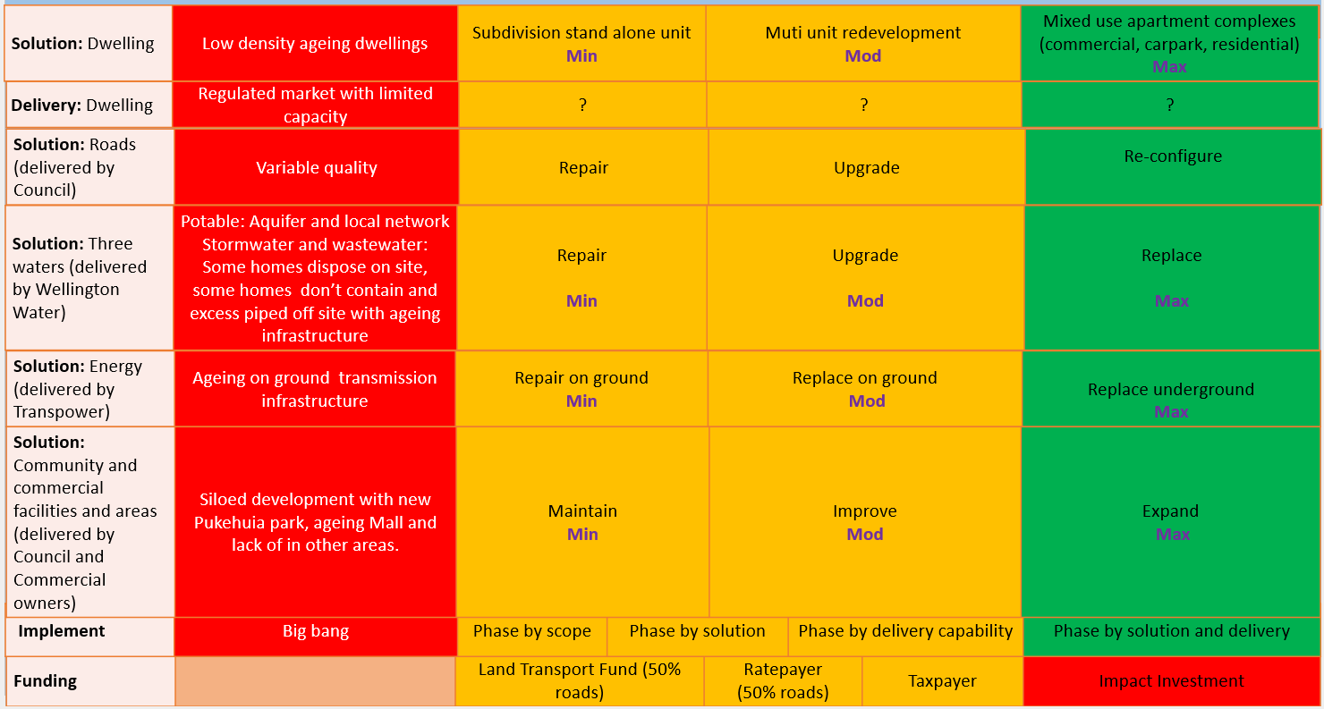
Enabling Infrastructure Backed by economic analysis, we will engage with infrastructure providers and decision makers to identify the best value option for each type of infrastructure

Slide 14
Aligned resilience areas to NPPA 2022 Survey results
Social
community activities such as market days, annual fair, picnic
improve youth outcomes
improved safety (lighting, high crime rate and resident safety)
community gardens-teaching home gardening
improved signage welcoming people to Newlands and Paparangi
Cultural
Marae open days
information about Maori sites
Built Environment
establishment of neighbourhood watch
Governance
advocate for community facilities
Infrastructure
improved Newlands Mall
improved underground services (eg water) and transport
.

Slide 15
Next Steps
Start-up decision 28 June 2023 to:
request Council and Government feedback
approach Philanthropy NZ to test interest from impact investors
request commitment from local leaders and potential service provider/s
search for PHD student to evaluate our journey
Initiate decision 28 September 2023, depending on feedback, interest and commitment, to:
respond to feedback from Council and Government
secure final commitment from investors and service providers
discuss good faith governance
do detailed planning/design to inform the November decision
Implement decision 22 November 2023 to:
consider October survey results
sign agreements with investors and service providers
establish good faith governance to govern the implementation
secure PHD student to evaluate our journey
implement the preferred option from February to October 2024

